Slide 1
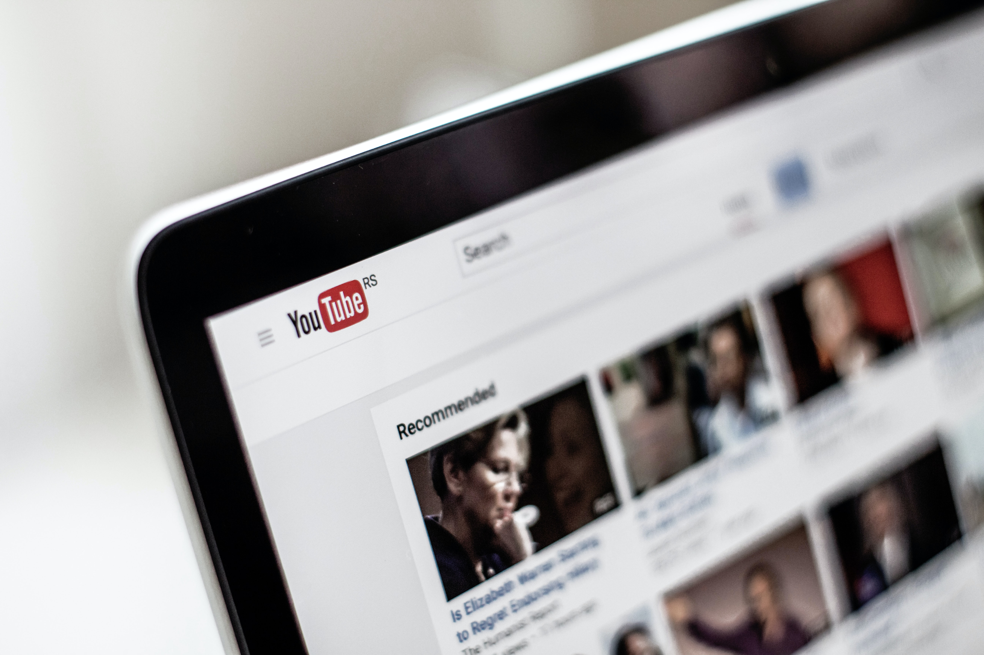

Influence of Social Media Ads on Buying Decisions & Browsing Experience
Paavna Suresh Ebube Iheme
Zhaoyi Wang Fan Peng

Slide 2

Introduction
Our goal for this project was to understand consumer’s attitudes towards online ads, specifically on social media platforms
We also wanted to discover if/how these ads influence consumers to explore brands/services and make purchases
Why social media?
More than half of the global population use social media actively
Social media continues to be a prime marketing channel across many industries
Our focus would be on one of the two largest platforms: Instagram & YouTube
Finally, insights from this analysis could reveal
How best to position their ads
The best target audience for their products
Preferred ad designs
Attitudes towards personalization and ad volume, and much more….

Slide 3

Secondary Research
More than 40% of users have visited, liked or followed a brand’s page in the past month
Average time digital consumers spend on social media is 2 hours 26 minutes per day
1
4
Personalization has also become a way for marketers to deliver tailored messaging to consumers
There are 3.196 billion active social media users across the globe
2
5
According to survey monkey, 74% of users think online ads have become too much with 44% of people finding most ads irrelevant to what they need.
28% of these consumers say online ads help them find out about new products
3
6

Slide 4

Interviews
Students
vs
young working individuals
8
individuals
Goal: understand how they interact with ads while browsing YouTube and Instagram.
Notes:
Paavna

Slide 5





What did we learn?
More time was spent on YouTube compared to Instagram
Overall dissatisfaction with the number of ads on YouTube
Personalization is the “new normal”
Ads on Instagram were explored more
Notes:
Paavna

Slide 6
Survey: What changed and How we did it?
What?
Method
Screening
Sources
Internal contacts
LinkedIn
Personal contacts
Explored more into frequent vs infrequent users
Users of either YouTube or Instagram or both
Convenience sampling
Notes:
Paavna

Slide 7
Survey Research: Demographics
Survey Metrics
Age
Education
Ethnicity
Gender
Income
Respondents: 131
Completed Responses: 76
Partial Responses: 55
Survey Period: 2 Weeks
(03/24/2020 - 04/10/2020)

Slide 8
Demographics: Age & Education
Age Distribution
Mean | 25.10
Median | 23
Mode | 22
St Dev | 5.98
Samp Variance | 35.72
Min | 16
Max | 56
Count | 72

Slide 9
Demographics: Ethnicity, Gender and Income

Slide 10
Interesting Insights

Slide 11
Interesting Insights

Slide 12
Deep dive
Personalization
Browsing experience and ad blockers
Ad exploration and influence on buying decision
Notes:
Paavna

Slide 13

Part 1.
Personalization

Slide 14
Is the proportion of people, who think their ads are personalized, different for Instagram and YouTube?
Categories | Instagram | YouTube | Total
Personalized | 28 | 10 | 38
Not Personalized | 34 | 60 | 94
Total | 62 | 70 | 132
Observed Values
P-value = 0.000098 < 0.05
Categories | Instagram | YouTube | Total
Personalized | 17.85 | 49.85 | 67.70
Not Personalized | 17.85 | 49.85 | 67.70
Total | 35.70 | 99.70 | 135.39
Expected Values
Conclusion: The proportion of people who think their ads are personalized is significantly different for Instagram and YouTube at 5% confidence level.

Slide 15
Relationship Between Personalization Level and Frequency of Seeing Ads on Instagram vs. YouTube
 | Coefficients | Standard Error | t Stat | P-value
Intercept | -0.2288272 | 0.36448734 | -0.6278056 | 0.532090365
Time spent on Instagram per day | 0.57087537 | 0.17288673 | 3.30201953 | 0.001487953
Frequency of seeing ads on Instagram | 0.50696337 | 0.0870665 | 5.82271455 | 1.44367E-07
R Square: 0.55012846
Adjusted R Square: 0.53780322
Conclusion: There is a significant linear relationship between personalization level on Instagram, time spent on Instagram per day and frequency of seeing ads on Instagram at 5% confidence level.
 | Coefficients | Standard Error | t Stat | P-value
Intercept | 0.66795263 | 0.47952574 | 1.39294427 | 0.16786428
Time spent on YouTube per day | 0.16049618 | 0.1574529 | 1.01932825 | 0.31141352
Frequency of seeing ads on YouTube | 0.28175582 | 0.09959263 | 2.82908297 | 0.00602368
R Square: 0.14668369
Adjusted R Square: 0. 12330516
Conclusion: There is a significant linear relationship between personalization level on YouTube and frequency of seeing ads on YouTube at 5% confidence level.

Slide 16
Part 2.
Browsing experience and ad blockers

Slide 17
Are people who use Instagram vs YouTube regularly more likely to block ads in some way?
Observed Values
Expected Values
 | Regular users | Non-regular users | Total
Block ads | 24 | 28 | 52
Don't block ads | 6 | 18 | 24
Total | 30 | 46 | 76
 | Regular users | Non-regular users | Total
Block ads | 20.53 | 31.47 | 52
Don't block ads | 9.47 | 14.53 | 24
Total | 30 | 46 | 76
P-value = 0.079 > 0.05
Conclusion: People who use Instagram regularly are not significantly likely to block ads than non-regular users at 5% confidence level.
 | Regular users | Non-regular users | Total
Block ads | 22 | 8 | 30
Don't block ads | 20 | 26 | 46
Total | 42 | 34 | 76
 | Regular users | Non-regular users | Total
Block ads | 16.58 | 13.42 | 30
Don't block ads | 25.42 | 20.58 | 46
Total | 42 | 34 | 76
Conclusion: People who use YouTube regularly are significantly more likely to block ads in some way than non-regular users at 5% confidence level.
P-value = 0.011 < 0.05

Slide 18
Browsing Experience on Instagram vs. YouTube
R Square: 0.64004318
Adjusted R Square: 0.58466521
R Square: 0.47412648
Adjusted R Square: 0.39322286
 | Coefficients | Standard Error | t Stat | P-value
Intercept | -0.7666984 | 0.76096443 | -1.0075351 | 0.317413719
Time spent on Instagram per day | 0.39076297 | 0.15098562 | 2.58808069 | 0.011893937
Frequency of seeing ads on Instagram | 0.05606178 | 0.0859469 | 0.65228394 | 0.51651817
Ads relevant to interests | 0.65689848 | 0.13695468 | 4.79646627 | 9.80461E-06
Ads with sales promotions | 0.10069667 | 0.12976456 | 0.7759952 | 0.440566262
Ad reliability (ad matches product on the landing page) | -0.3100006 | 0.14293936 | -2.1687556 | 0.033765874
Ad design quality | -0.0906911 | 0.106189 | -0.8540538 | 0.396211823
Total number of ads you see | 0.27709983 | 0.10706864 | 2.58805785 | 0.011894651
Personalization level on Instagram | 0.10877822 | 0.09808972 | 1.10896657 | 0.271530896
Is Male | 0.13111449 | 0.21574779 | 0.60772112 | 0.545489928
Education level | -0.1179726 | 0.1587771 | -0.7430074 | 0.460154261
 | Coefficients | Standard Error | t Stat | P-value
Intercept | 0.09738063 | 0.7551142 | 0.12896146 | 0.89778636
Time spent YouTube per day | 0.06848918 | 0.10936773 | 0.62622844 | 0.533358168
Frequency of seeing ads on YouTube | 0.15833735 | 0.07227465 | 2.19077281 | 0.032059942
Ads relevant to interests | 0.33487156 | 0.12679285 | 2.64109187 | 0.010338936
Ads with sales promotions | -0.2370214 | 0.12441669 | -1.9050615 | 0.061197793
Ad reliability (ad matches product on the landing page) | 0.05960732 | 0.13839688 | 0.4306984 | 0.668112544
Ad design quality | 0.05517753 | 0.10363944 | 0.53239897 | 0.596265016
Total number of ads you see | 0.28070823 | 0.10351688 | 2.7117146 | 0.008554826
Personalization level on YouTube | 0.13331935 | 0.08226297 | 1.62064849 | 0.109934726
Is Male | 0.79618191 | 0.21332158 | 3.73230836 | 0.000401268
Education level | -0.338731 | 0.15134558 | -2.2381291 | 0.028644805

Slide 19
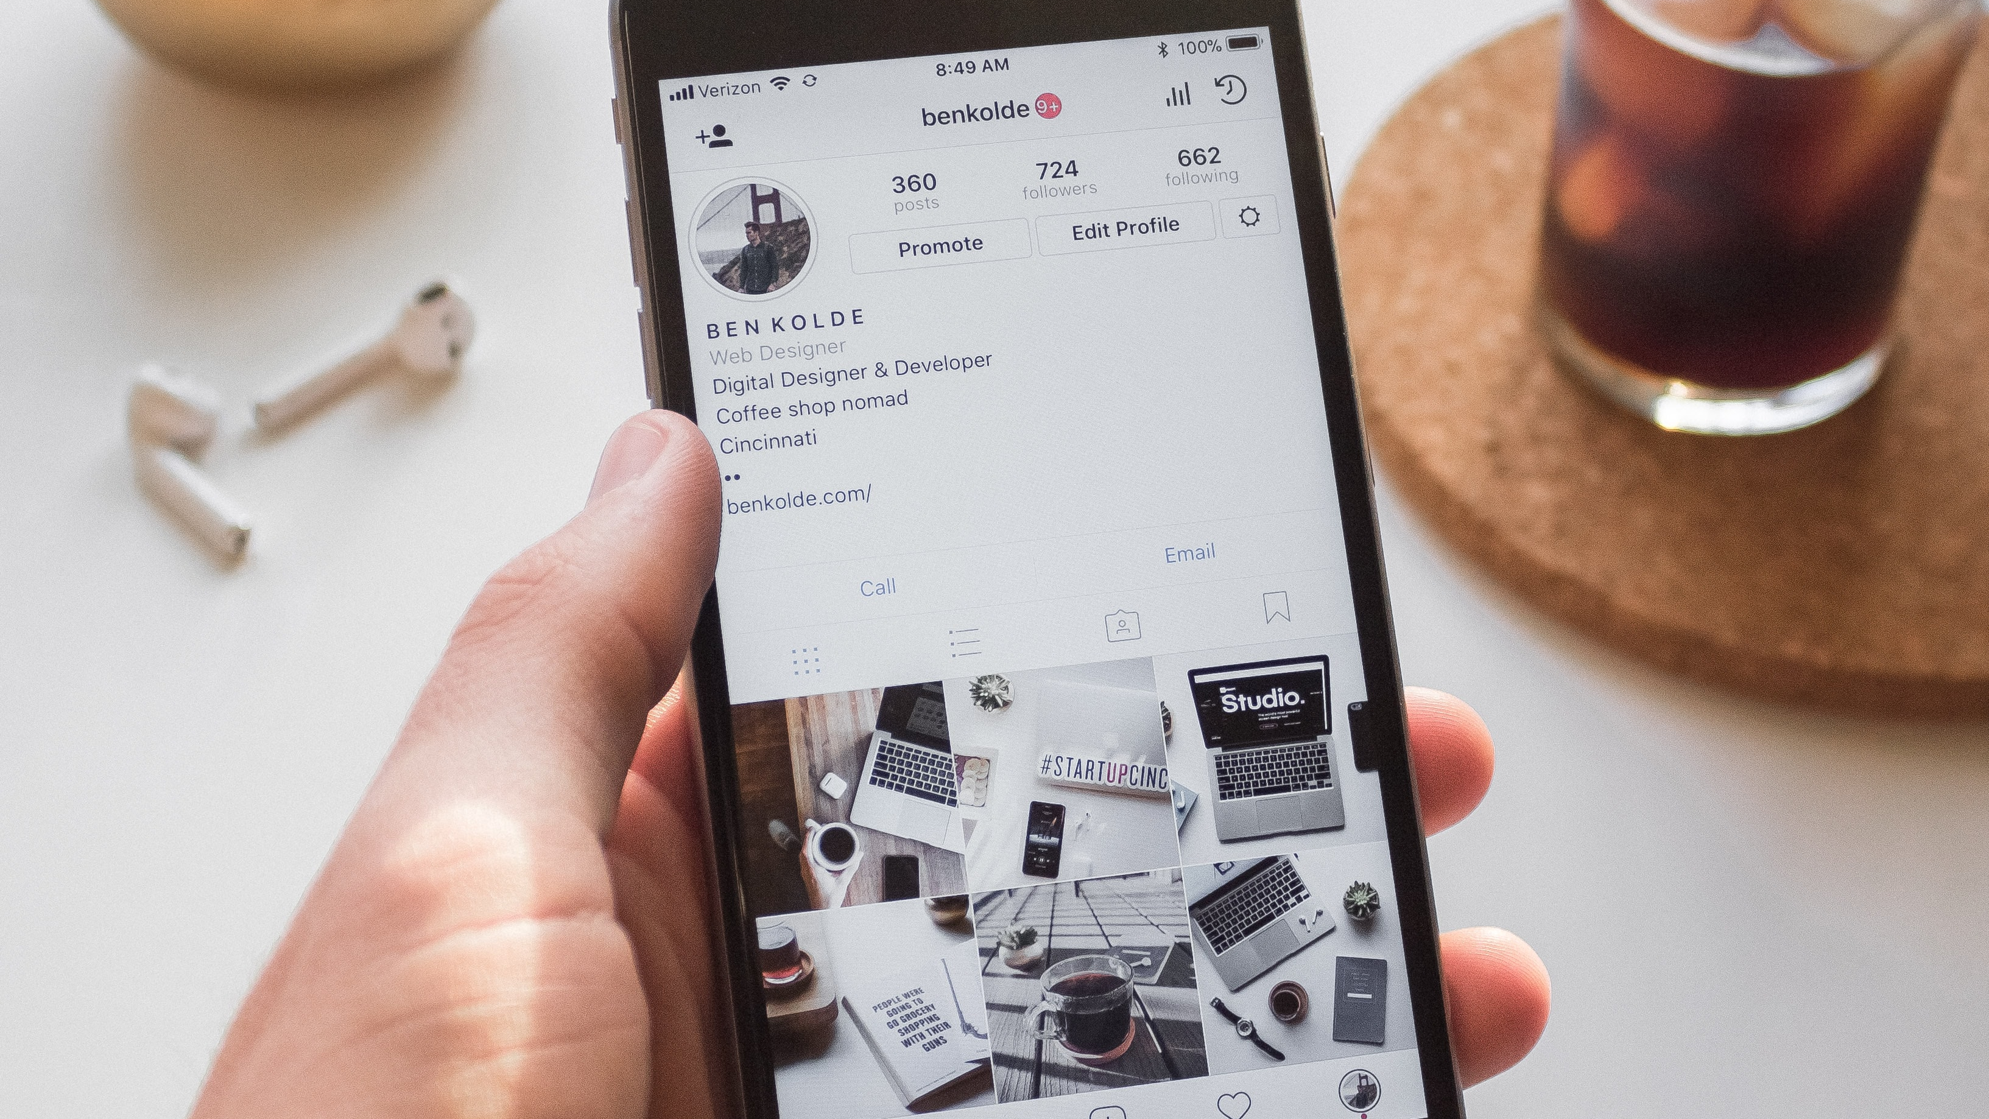
Part 3.
Ad Exploration and
Influence on Buying Decision

Slide 20
Instagram vs. YouTube
Likelihood to Explore an Ad
Frequency of Obtaining Products through Ads
 | Instagram | On YouTube
Mean | 2.13157895 | 1.93421053
Variance | 2.54245614 | 1.7422807
Observations | 76 | 76
Pearson Correlation | 0.33359262
Hypothesized Mean Difference | 0
df | 75
t Stat | 1.01379125
P(T<=t) one-tail | 0.1569709
t Critical one-tail | 1.66542537
P(T<=t) two-tail | 0.31394181
t Critical two-tail | 1.99210215
 | Instagram | YouTube
Mean | 1.48684211 | 1.27631579
Variance | 1.13315789 | 0.60263158
Observations | 76 | 76
Pearson Correlation | 0.35135973
Hypothesized Mean Difference | 0
df | 75
t Stat | 1.7076769
P(T<=t) one-tail | 0.04591644
t Critical one-tail | 1.66542537
P(T<=t) two-tail | 0.09183287
t Critical two-tail | 1.99210215
Conclusion: There is not a significant difference of likelihood to explore an ad on between Instagram and YouTube.
Conclusion: There is not a significant difference of frequency of obtaining products through ads between Instagram and YouTube.

Slide 21
Likelihood to Explore Ads on Instagram vs. YouTube
R Square | 0.59250447
Adjusted R Square | 0.51488627
R Square | 0.44236506
Adjusted R Square | 0.33614888
 | Coefficients | Standard Error | t Stat | P-value
Intercept | -2.3045674 | 1.07763553 | -2.1385407 | 0.03635693
Money spent on online shopping per month | 0.25351997 | 0.19928684 | 1.27213604 | 0.20800042
Frequency of shopping online | -0.1882294 | 0.15077396 | -1.2484213 | 0.21649643
Time spent on Instagram per day | 0.61988249 | 0.19494389 | 3.17979944 | 0.00228644
Frequency of seeing ads on Instagram | 0.06958262 | 0.10920441 | 0.63717777 | 0.52631786
Ads relevant to interests | 0.33789847 | 0.17399623 | 1.9419873 | 0.05661283
Ads with sales promotions | -0.3019304 | 0.17446117 | -1.7306451 | 0.0884108
Ad reliability | -0.3228837 | 0.18379357 | -1.7567739 | 0.08381541
Ad design quality | 0.24090924 | 0.135959 | 1.77192569 | 0.08124252
Total number of ads you see | 0.42832946 | 0.14027734 | 3.05344721 | 0.00331216
Personalization level on Instagram | 0.19874721 | 0.12482411 | 1.59221804 | 0.11634133
Is Male | -0.5249103 | 0.27746669 | -1.8917958 | 0.06311641
Education level | 0.41314292 | 0.21049098 | 1.96275836 | 0.05409341
 | Coefficients | Standard Error | t Stat | P-value
Intercept | -1.875445 | 1.08161387 | -1.7339321 | 0.08782151
Money spent on online shopping per month | 0.12599941 | 0.19218973 | 0.65559907 | 0.51446919
Frequency of shopping online | 0.06528599 | 0.14499006 | 0.45027904 | 0.65405498
Time spent on YouTube per day | 0.04897995 | 0.13976383 | 0.35044799 | 0.72717158
Frequency of seeing ads on YouTube | 0.13740437 | 0.09326863 | 1.47321104 | 0.14567316
Ads relevant to interests | 0.21126661 | 0.1619499 | 1.30451826 | 0.1968025
Ads with sales promotions | -0.38844 | 0.16803445 | -2.311669 | 0.02407864
Ad reliability | -0.1878835 | 0.17889344 | -1.0502538 | 0.29761358
Ad design quality | 0.40222976 | 0.13340023 | 3.0152104 | 0.00369871
Total number of ads you see | 0.30505271 | 0.13612488 | 2.24097682 | 0.02856059
Personalization level on YouTube | 0.28458804 | 0.1057249 | 2.69177886 | 0.00909177
Is Male | -0.0514145 | 0.27635407 | -0.1860458 | 0.85300663
Education level | 0.27101625 | 0.20085755 | 1.34929579 | 0.18207132

Slide 22
Frequency of Obtaining Products and Service on Instagram vs. YouTube
R Square | 0.60559059
Adjusted R Square | 0.5150704
R Square | 0.60947682
Adjusted R Square | 0.51984854
 | Coefficients | Standard Error | t Stat | P-value
Intercept | -1.1745104 | 0.84215454 | -1.3946495 | 0.1681799
Online shopping enjoyment | 0.15329194 | 0.11019755 | 1.39106484 | 0.16925906
Likelihood to explore ads on Instagram | 0.33931573 | 0.08638787 | 3.92781663 | 0.00022099
Money spent on online shopping per month | 0.17347984 | 0.13754755 | 1.26123541 | 0.21202623
Frequency of shopping online | -0.0122392 | 0.10689806 | -0.1144944 | 0.90922191
Time spent on Instagram per day | 0.05058962 | 0.14017927 | 0.36089233 | 0.71942678
Frequency of seeing ads on Instagram | -0.0408529 | 0.07402309 | -0.5518939 | 0.58303741
Ads relevant to interests | 0.10174081 | 0.12121589 | 0.83933563 | 0.40455842
Ads with sales promotions | -0.0937125 | 0.11941935 | -0.7847343 | 0.43564646
Ad reliability | 0.07340095 | 0.12832793 | 0.5719795 | 0.56943779
Ad design quality | 0.03346331 | 0.09600475 | 0.34855897 | 0.72862061
Total number of ads you see | 0.1211609 | 0.10043179 | 1.20639986 | 0.2323214
Personalization level on Instagram | 0.12084483 | 0.08531315 | 1.41648542 | 0.16172008
Is Male | 0.57091513 | 0.20911816 | 2.73010778 | 0.00826437
Education level | -0.0731834 | 0.14716616 | -0.497284 | 0.62077653
 | Coefficients | Standard Error | t Stat | P-value
Intercept | -0.1617912 | 0.62743652 | -0.2578606 | 0.797382425
Online shopping enjoyment | 0.14152683 | 0.07756885 | 1.82453165 | 0.072969889
Likelihood to explore ads on YouTube | 0.29668932 | 0.06462783 | 4.59073596 | 2.25818E-05
Money spent on online shopping per month | -0.0777627 | 0.09848451 | -0.7895936 | 0.432823696
Frequency of shopping online | -0.0941334 | 0.07549811 | -1.2468315 | 0.217225689
Time spent on YouTube per day | -0.0039105 | 0.07003909 | -0.0558333 | 0.955657122
Frequency of seeing ads on YouTube | -0.0052532 | 0.04745022 | -0.1107104 | 0.912209472
Ads relevant to interests | 0.08728859 | 0.08237355 | 1.05966771 | 0.293473752
Ads with sales promotions | 0.08572504 | 0.0878152 | 0.97619823 | 0.332821816
Ad reliability | 0.04202182 | 0.09145421 | 0.45948476 | 0.647519465
Ad design quality | -0.0741395 | 0.07383433 | -1.0041334 | 0.319281005
Total number of ads you see | 0.08620168 | 0.0707489 | 1.21841735 | 0.22775686
Personalization level on YouTube | 0.10064379 | 0.05600234 | 1.79713541 | 0.077264646
Is Male | 0.67299277 | 0.15466738 | 4.35122643 | 5.24404E-05
Education level | -0.0603467 | 0.10420909 | -0.5790927 | 0.564659009

Slide 23
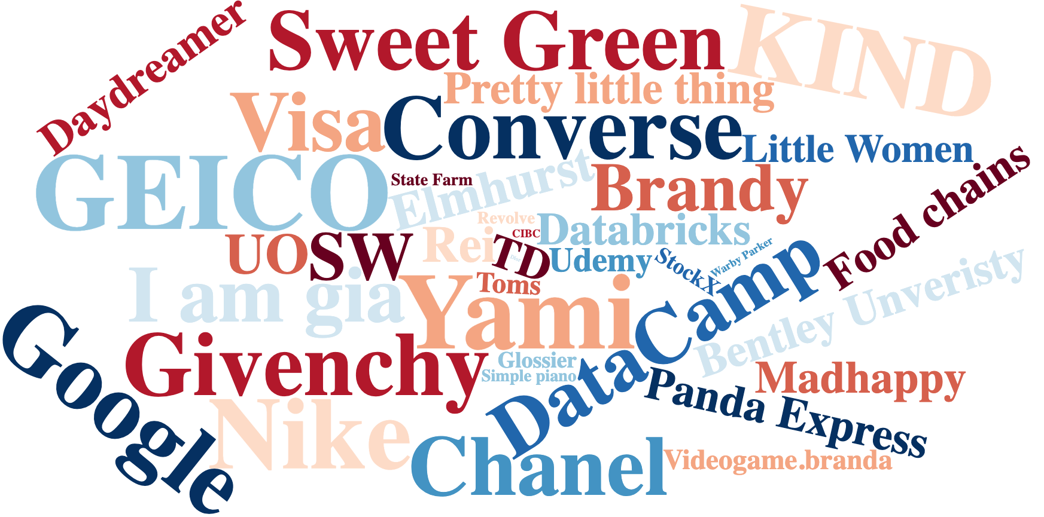
Memorable Brands

Slide 24
Conclusion
More Instagram users (45%) than YouTube users (17%) think that their ads are personalized
For both platforms, the more ads users see, the more personalized they think the ads are, on average
A significant positive relationship between number of ads viewed, relevant ads and browsing experience across both platforms
However, on YouTube regular users are significantly more likely to block ads than non-regular users
No strong evidence that either platform’s users are more likely to explore an ad or obtain a product or service through an ad
Relevant or personalized ads on both platforms increase user likelihood to explore an ad
Ad design quality is a more significant predictor of ad exploration on YouTube than Instagram
Overall, our main takeaway is that personalization is very important for increasing ad exploration and browsing experience on social media.

Slide 25
Q&A
Thanks!

